Slide 1

Requirements Engineering: Processes and Techniques by Kotonya and Sommerville

Slide 2

To introduce non-functional requirements
To explain the schemes used to classify non-functional requirements
To illustrate various derivation techniques for non-functional requirements
To demonstrate the importance of non-functional requirements in critical systems

Slide 3

Non-functional requirements define the overall qualities or attributes of the resulting system
Non-functional requirements place restrictions on the product being developed, the development process, and specify external constraints that the product must meet.
Examples of NFR include safety, security, usability, reliability and performance requirements.

Slide 4

There is no a clear distinction between functional and non-functional requirements.
Whether or not a requirement is expressed as a functional or a non-functional requirement may depend:
  on the level of detail to be included in the requirements document
  the degree of trust which exists between a system customer and a system developer.

Slide 5

The system shall ensure that data is protected from unauthorised access.
  Conventionally, this would be considered as a non-functional requirement because it does not specify specific system functionality which must be provided. However, it could have been specified in slightly more detail as follows:
  The system shall include a user authorisation procedure where users must identify themselves using a login name and password. Only users who are authorised in this way may access the system data.
  In this form, the requirement looks rather more like a functional requirement as it specifies a function (user login) which must be incorporated in the system.

Slide 6

The ‘IEEE-Std 830 - 1993’ lists 13 non-functional requirements to be included in a Software Requirements Document.
  Performance requirements
  Interface requirements
  Operational requirements
  Resource requirements
  Verification requirements
  Acceptance requirements

Slide 7

  Documentation requirements
  Security requirements
  Portability requirements
  Quality requirements
  Reliability requirements
  Maintainability requirements
  Safety requirements

Slide 8

NFRs may be classified n terms of qualities that a software must exhibit (Boehm)
A more general classification distinguishes between product, process and external requirements

Slide 9

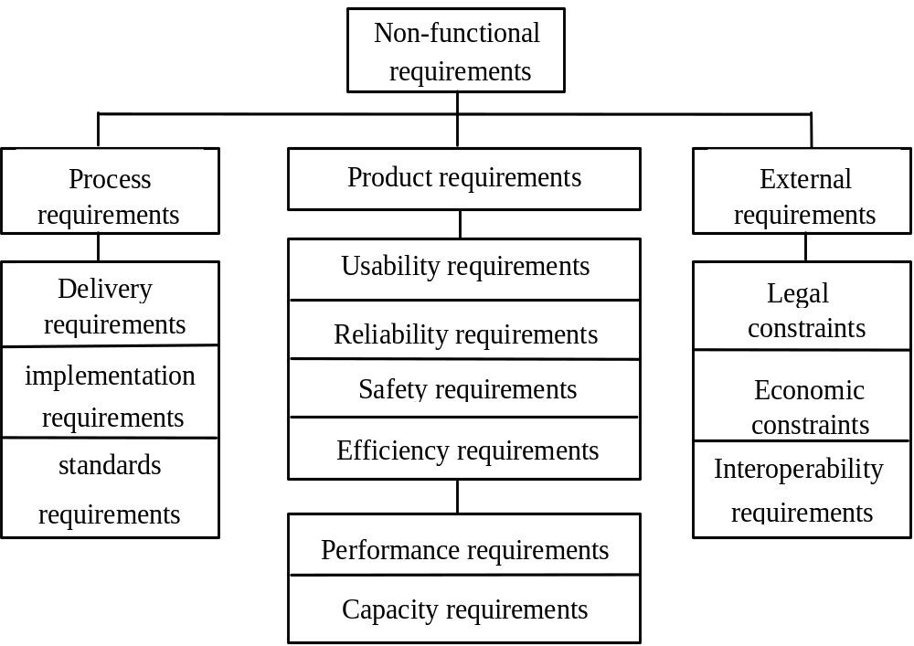

Slide 10

Specify the desired characteristics that a system or subsystem must possess.
Most NFRs are concerned with specifying constraints on the behaviour of the executing system.

Slide 11

Some product requirements can be formulated precisely, and thus easily quantified
  Performance
  Capacity
Others are more difficult to quantify and, consequently, are often stated informally
  Usability

Slide 12

The System service X shall have an availability of 999/1000 or 99%. This is a reliability requirement which means that out of every 1000 requests for this service, 999 must be satisfied.
System Y shall process a minimum of 8 transactions per second. This is a performance requirement.
The executable code of System Z shall be limited to 512Kbytes. This is a space requirement which specifies the maximum memory size of the system.

Slide 13

There are product requirements which relate to the source code of the system
Examples
  The system shall be developed for PC and Macintosh platforms. This is a portability requirement which affects the way in which the system may be designed
  The system must encrypt all external communications using the RSA algorithm. This is a security requirement which specifies that a specific algorithm must be used in the product

Slide 14

Product requirements are often conflict. For example:
  A requirement for a certain level of performance may be contradicted by reliability and security requirements which use processor capacity to carry out dynamic system checking
  A requirement on the space utilisation of the system may be contradicted by another requirement which specifies that a standard compiler which does not generate compact code must be used
The process of arriving at a trade-off in these conflicts depends on:
  The level importance attached to the requirement
  The consequence of the change on the other requirements and,
  The wider business goals

Slide 15

Process requirements are constraints placed upon the development process of the system
Process requirements include:
  Requirements on development standards and methods which must be followed
  CASE tools which should be used
  The management reports which must be provided

Slide 16

The development process to be used must be explicitly defined and must be conformant with ISO 9000 standards
The system must be developed using the XYZ suite of CASE tools
Management reports setting out the effort expended on each identified system component must be produced every two weeks
A disaster recovery plan for the system development must be specified

Slide 17

May be placed on both the product and the process
Derived from the environment in which the system is developed
External requirements are based on:
  application domain information
  organisational considerations
  the need for the system to work with other systems
  health and safety or data protection regulations
  or even basic natural laws such as the laws of physics

Slide 18

Medical data system The organisation’s data protection officer must certify that all data is maintained according to data protection legislation before the system is put into operation.
Train protection system The time required to bring the train to a complete halt is computed using the following function:
The deceleration of the train shall be taken as:
  γ_{train} = γ_{control} + γ_{gradient}
  where:

Slide 19

γ_{gradient} = 9.81 ms⁻² * compensated gradient / alpha and where the values of 9.81 ms^{-2/} alpha are known for the different types of train.
γ_{control} is initialised at 0.8 ms⁻² - this value being parameterised in order to remain adjustable. The illustrates an example of the train’s deceleration by using the parabolas derived from the above formula where there is a change in gradient before the (predicted) stopping point of the train.

Slide 20

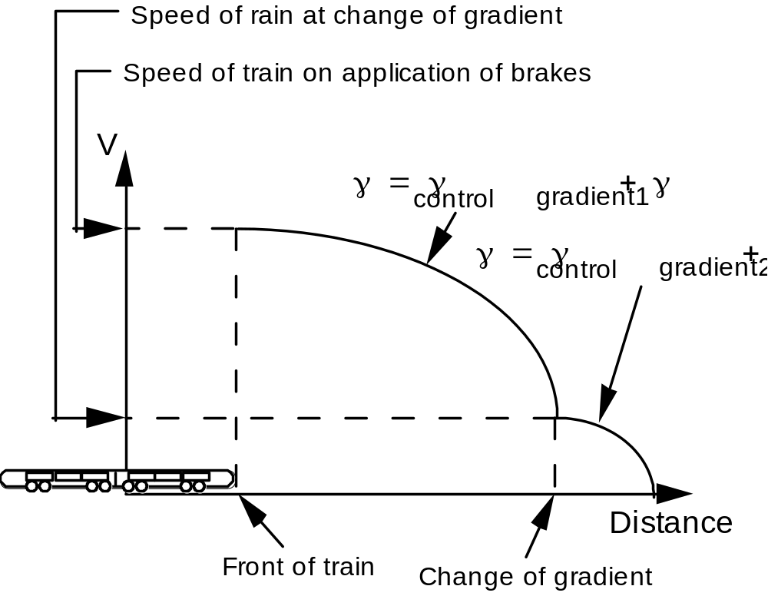

Slide 21
The first of the the requirements described comes from the need for the system to conform to data protection legislation
The second comes from the application domain and is a specification of the physical braking characteristics of a train.
External requirements rarely have the form “the system shall...” or ‘the system shall not...”. Rather, they are descriptions of the system’s environment which must be taken into account.

Slide 22

NFRs are difficult to express
A number of important issues contribute to the problem of expressing non-functional requirements:
  Certain constraints are related to the design solution that is unknown at the requirements stage
  Certain constraints, are highly subjective and can only be determined through complex empirical evaluations
  Non-functional requirements tend to be related to one or more functional requirements
  Non-functional requirements tend to conflict and contradict
  There are no ‘universal’ rules and guidelines for determining when non-functional requirements are optimally met.

Slide 23

Stakeholders normally have a number of ‘concerns’
Concerns are typically non-functional
Examples include:
  Critical business objectives
  Essential system characteristics (e.g. security)
  Safety, performance, functionality and maintainability
Vaguely defined user concerns may be related to NFRs

Slide 24

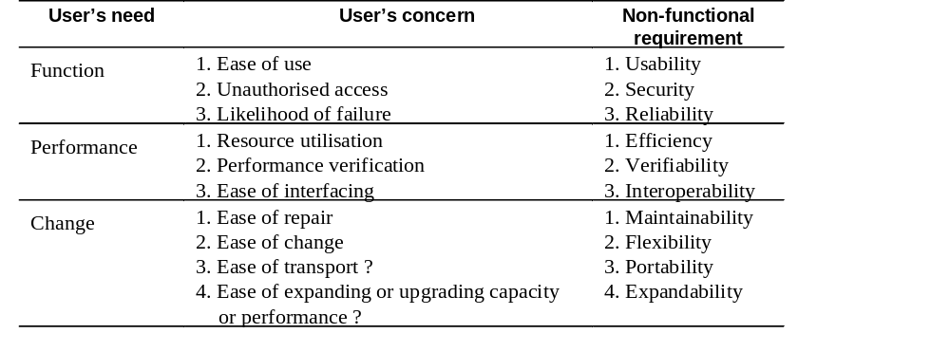

Slide 25

A way of expressing critical ‘holistic’ requirements
Concerns may be broken down into sub-concerns and finally into specific questions
Questions act as a check list to ensure that specific requirements do not conflict with global priorities

Slide 26

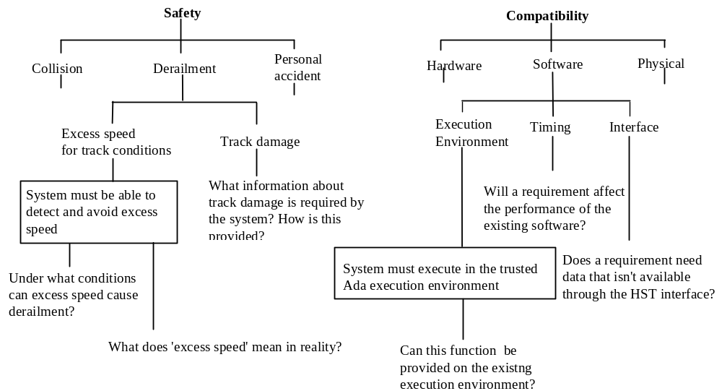

Slide 27

Relates non-functional requirements to the goals of the enterprise
Goal-based NFR derivation is a 3 step approach:
  Identify the enterprise goal
  Decompose of the goal into sub-goals
  Identify non-functional requirements.

Slide 28

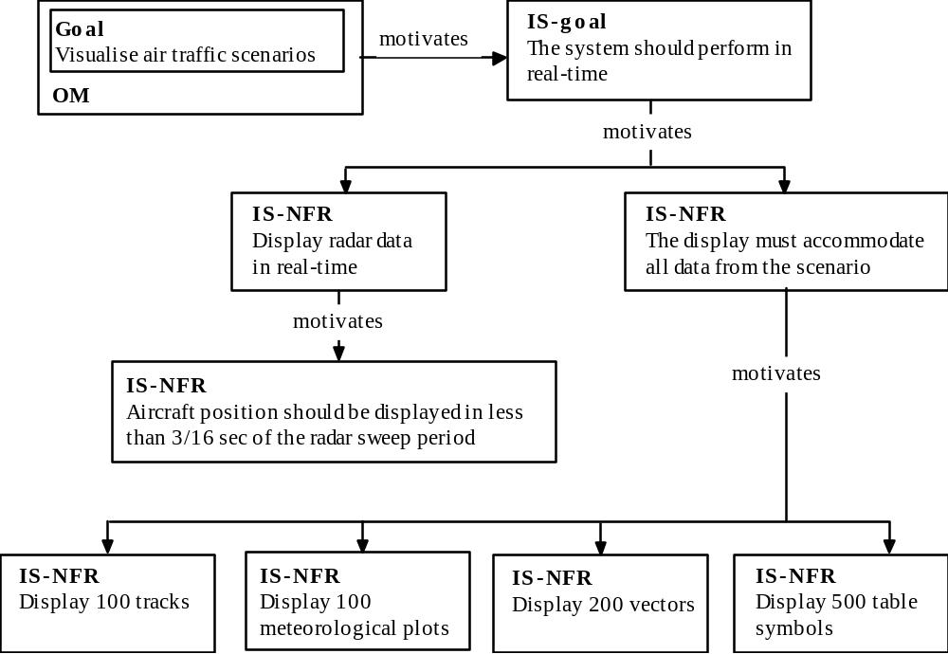

Slide 29

Stakeholders may have vague goals which cannot be expressed precisely
Vague and imprecise ‘requirements’ are problematic
NFRs should satisfy two attributes
  Must be objective
  Must be testable (Use measurable metrics)
It is not always possible to express NFRs objectively

Slide 30

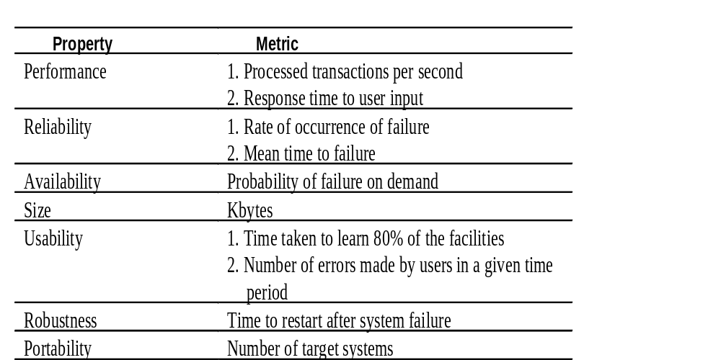

Slide 31

Systems whose ‘failure’ causes significant economic, physical or human damage to organisations or people.
There are three principal types of critical system:
  Business critical systems
  Mission critical systems
  Safety critical systems

Slide 32

The principal non-functional constraints which are relevant to critical systems:
  Reliability
  Performance
  Security
  Usability
  Safety

Slide 33

Constraints on the run-time behaviour of the system
Can be considered under two separate headings:
  Availability - is the system available for service when requested by end-users.
  Failure rate - how often does the system fail to deliver the service expected by end-users.

Slide 34

Constrain the speed of operation of a system
Types of performance requirements:
  Response requirements
  Throughput requirements
  Timing requirements

Slide 35

Security requirements are included in a system to ensure:
  Unauthorised access to the system and its data is not allowed
  Ensure the integrity of the system from accidental or malicious damage
Examples of security requirements are:
  The access permissions for system data may only be changed by the system’s data administrator
  All system data must be backed up every 24 hours and the backup copies stored in a secure location which is not in the same building as the system
  All external communications between the system’s data server and clients must be encrypted

Slide 36

Concerned with specifying the user interface and end-user interactions with the system
Well structured user manuals, informative error messages, help facilities and consistent interfaces enhance usability

Slide 37

Measurable attributes of usability requirements include:
  Entry requirements Measured in terms of years of experience with class of applications or simply age
  Learning requirements Denotes the time needed to learn the facilities of the system. This could be measured in terms of speed of learning, say hours of training required before independent use is possible
  Handling requirements Denotes the error rate of the end-users of the system. This could be measured in terms of the errors made when working at normal speed
  Likeability Denotes ‘niceness’ to use. The most direct to measure user satisfaction is to survey actual users and record the proportion who ‘like to work with the product’

Slide 38

Provides an automated support facility for setting and measuring usability
Provides a set of ‘templates’ which have to be filled in

Slide 39

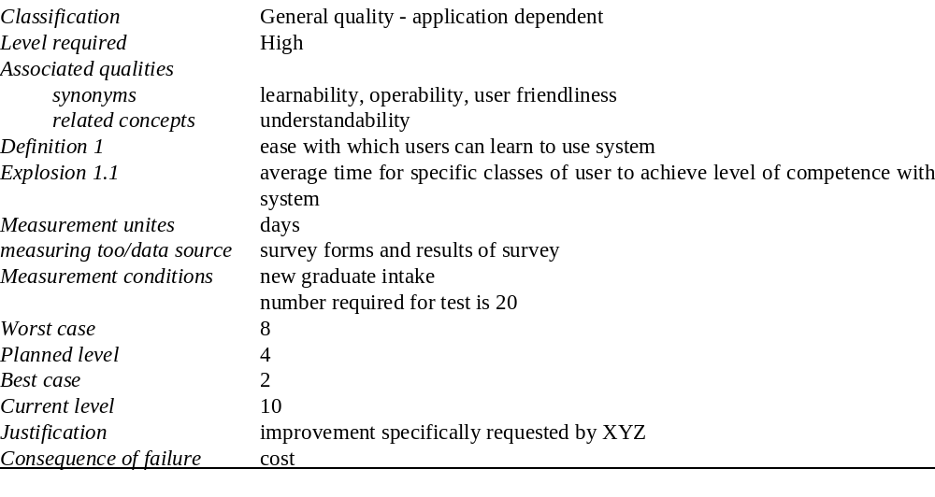

Slide 40

No consensus in the system’s engineering community about what is meant by the term ‘safety requirement’
  Sometimes considered to be all requirements (functional and non-functional) on safety-related systems
  Sometimes the sub-set of these requirements which are directly related to ensuring safe operation and sometimes requirements on protection systems which are designed to protect against accident
Usage of the term often depends on the culture and practice of the organisation

Slide 41

Informal definition:
Safety requirements are the ‘shall not’ requirements which exclude unsafe situations from the possible solution space of the system

Slide 42

The system shall not permit operation unless the operator guard is in place
The system shall not allow the sedative dose delivered to the patient to be greater than the maximum value which is determined by the patient’s physician
The system shall not operate if the external temperature is below 4 degrees Celsius

Slide 43

The requirements engineering process for safety-related systems should incorporate a specific safety-analysis activity
The widely accepted model of the system critical systems life cycle (BCS and IEE 1989) identifies two stages in the safety analysis process:
  Safety requirements discovery
  Safety validation

Slide 44

As part of the process of safety analysis, there are various activities such as hazard identification and analysis
Various methods such as fault-tree analysis and Petri net analysis have been developed for safety validation

Slide 45

We illustrate in the following sections a simple technique for integrating safety analysis with a requirements engineering method
The technique is intended to support the process of requirements discovery (safety requirements) and validation

Slide 46

The starting point for specifying the system is a set of abstract organisational needs and constraints
It is important that the approach used incorporates a systematic approach to dealing safety issues. These include:
  Identifying hazards, risks and risk criteria
  Identifying the necessary risk reduction to meet the risk criteria
  Defining the overall safety requirements specification for the safeguards necessary to achieve the required risk reduction

Slide 47
The requirements process, shown in , has been extended to incorporate an explicit safety analysis activity
The safety analysis process is based on requirements information drawn from the requirements elicitation and documentation process
A set of abstract safety requirements serves as a reference model for identifying initial safety considerations or concerns

Slide 48
The safety analysis process includes:
  The identification of safety considerations
  Hazard identification
  Hazard analysis
  Risk analysis and derivation of safety requirements
Proposed safety requirements are analysed together with other system requirements to ensure that safety is not compromised

Slide 49
Abstract requirements
Requirements process
Elicit requirements
Analyse requirements
Document requirements
Validate requirements
Requirements document
Identify safety considerations
Identify hazards
Analyse hazards
Abstract safety requirements
Risk assessment
Suggested safety requirements
Safety analysis

Slide 50

Non-functional requirements define the overall qualities or attributes of the resulting system
Non-functional requirements may be classified into three main types; product, process and external requirements
Product requirements specify the desired characteristics that the system or subsystem must posses
Non-functional requirements tend to conflict and interact with other system requirements
The principal non-functional constraints which are relevant to critical systems are reliability, performance, security, usability and safety

